Slide 1
Micro Credit Loan
By
Dhara Patel

Slide 2
Business Problem Framing
Here in this dataset it provide micro-credit on mobile balances to be paid back in 5 days. The Consumer is believed to be defaulter if he deviates from the path of paying back the loaned amount within the time duration of 5 days. For the loan amount of 5 (in Indonesian Rupiah), payback amount should be 6 (in Indonesian Rupiah), while, for the loan amount of 10 (in Indonesian Rupiah), the payback amount should be 12 (in Indonesian Rupiah).

Slide 3
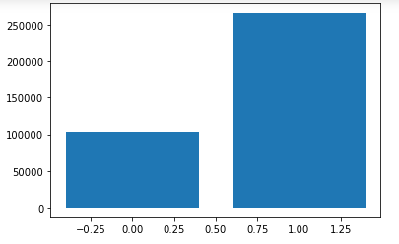
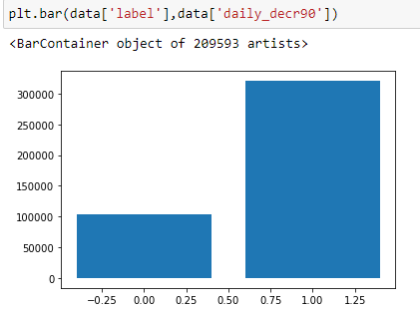
Analysis
This graph is about Daily amount spent from main account, averaged over last 30 days (in Indonesian Rupiah)
Daily amount spent from main account, averaged over last 90 days (in Indonesian Rupiah)

Slide 4
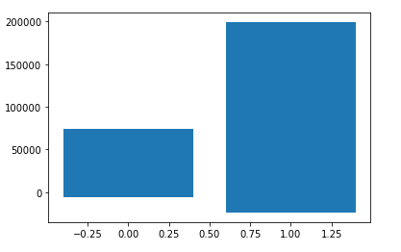
Average Main account balance
Show that Average main account balance over last 30 days and Average main account balance over last 90 days

Slide 5
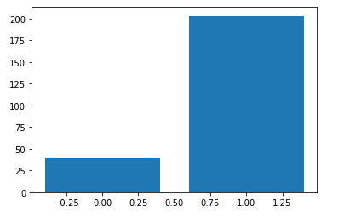
This graph is about label vs. Number of times main account got recharged in last 30 days
Here we can see that there are less defaulters whose main account got recharged in last 30 days.

Slide 6
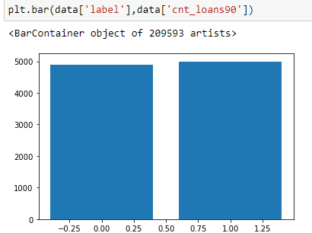
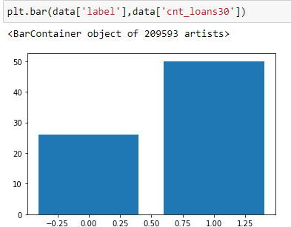
Number of loans taken by user in last 30 days and 90 days shown in figure.
There are maximum user who didn’t pay their loan in last 90 days. Compare to that there are less no. of students who didn’t pay their loan in last 30 days.

Slide 7
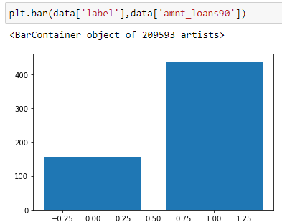
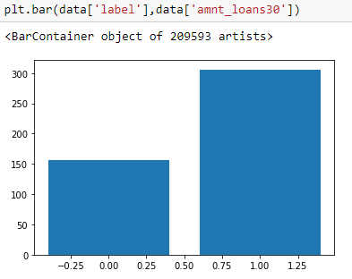
Total amount of loans taken by user in last 30 days and 90 days. Most of the user pay their loan amount which was taken in last 30 and 90 days. There are less user who didn’t pay their loan which is taken by in last 30 and 90 days.

Slide 8
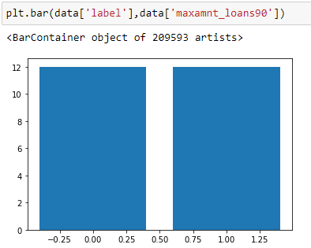
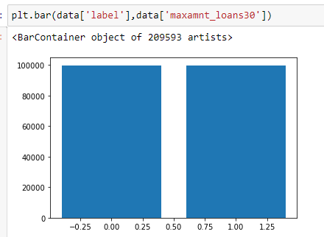
maximum amount of loan taken by the user in last 30 days and last 90 days. Figure show that defaulter and non-defaulter take maximum amount in last 30 days and 90 days.

Slide 9
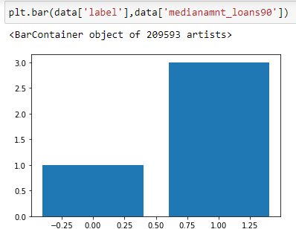
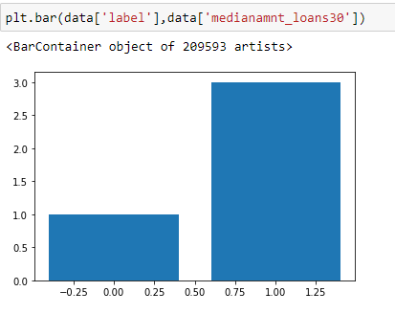
Median of amounts of loan taken by the user in last 30 days and last 90 days we can see that both amounts are almost same and and there are less no. of user who didn’t pay their loan.

Slide 10
After all analysis this data shows that average amount and minimum amount of loan paid by user almost.
But they are not able to pay maximum loan amount.
Here in this dataset we have drop some columns because they have 0 correlation with other columns.
This problem is a classification problem so we have to check with different models.

Slide 11
Accuracy Score of all model

Slide 12
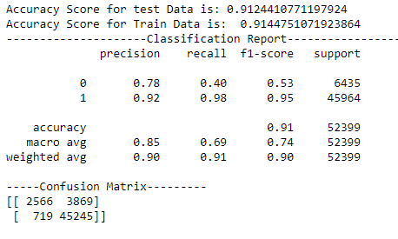
GradientBoostingClassifier() using Hyper Parameters we got 91.24% accuracy in using given dataset. Best precision, recall, f1-score using gradientbosstingclassifier().

Slide 13
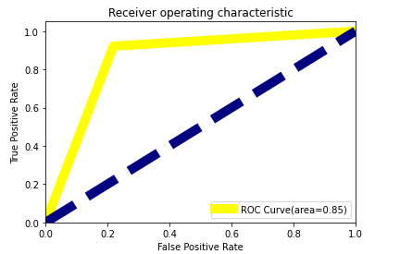
AUC-ROC Curve

Slide 14
Conclusion
If we decrease to give maximum loan amount then we will decrease loan defaulters.
Other vise put condition that after 2 loan user can not take loan. If user will pay the previous loan then after they will take loan.

